Slide 1
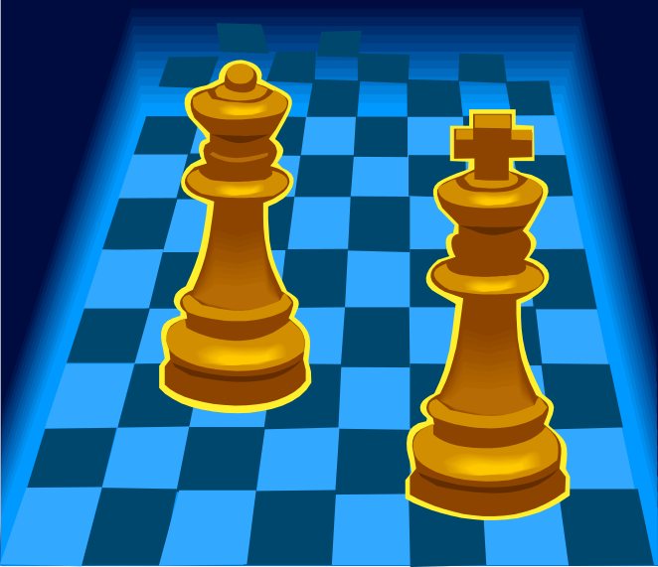
Advanced Game Playing
Alpha-Beta Pruning and Expectiminimax

Slide 2

Game-Playing
Alpha-Beta Pruning
Alpha-Beta Pruning is a branch-and-bound extension to Minimax that “prunes” (eliminates) unnecessary branches of the search tree.
Max
0
Min
A
0
A
0
B
0
B
1
0
C
D
A
B
0
1
0
0
1
0
D
D
C
C
D
D
C
C
D
D
C
C

Slide 3

Game-Playing
Alpha-Beta Pruning Algorithm
Move Minimax(player, gameState, alpha, beta) {
Move bestMove = null;
GameState newState = new GameState();
generate valid Moves for player;
for each Move move {
newState.copy(gameState);
newState.apply(move);
if (newState.isTerminal())
move.rank = evaluate(newState);
else
move.rank = Minimax(GetNextPlayer(), newState, alpha, beta).rank;
if (!bestMove || move.rank is better than bestMove.rank) {
bestMove = move;
if (player is max player and bestMove.rank > alpha)
alpha = bestMove.rank;
else if (player is min player and bestMove.rank < beta)
beta = bestMove.rank;
if (alpha >= beta)
break;
}
}
return bestMove;
}
NOTE: Alpha should initially be -∞ and beta should be +∞. Try Double.PositiveInfinity and Double.NegativeInfinity in your code.

Slide 4
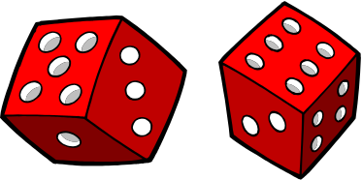
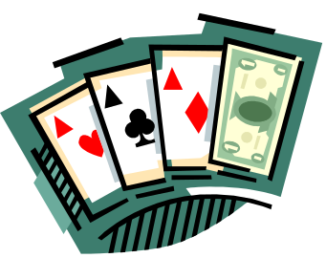
Game-Playing
Expectiminimax
Many games contain one or more random elements:
Monopoly
Backgammon
Card Games
For games of this type, we can use chance nodes to predict gameplay
by finding expectimax and expectimin values.
Die Roll
185
(Jail)
⅙
⅙
⅙
⅙
⅙
⅙
Expectimax
190
(StC)
140
(EC)
190
(SA)
190
(VA)
160
(RR)
240
(CC)
Buy
-20
Buy
Buy
+80
None
None
None
None
Evaluation
190
160
140
190
160
190
160
160
240

Slide 5

Game-Playing
Expectiminimax Problems
Drawbacks of Expectiminimax:
Tree grows even faster than Minimax
Many games are actually psychological (Poker)
Results can vary as based on move that is “likely” good
Expectiminimax works best when going only a few ply deep.

